Slide 1
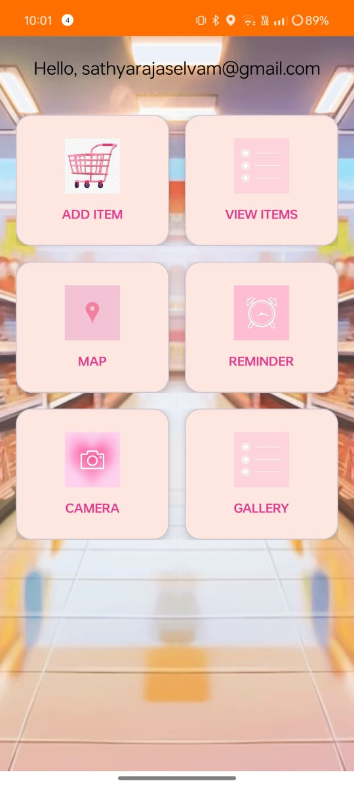
Home
Introduction
Similar Apps
Results
SHOP SMART.
Expiry Date Tracker
DONE BY: RAJA RAJESWARI R [22IT072]

Slide 2

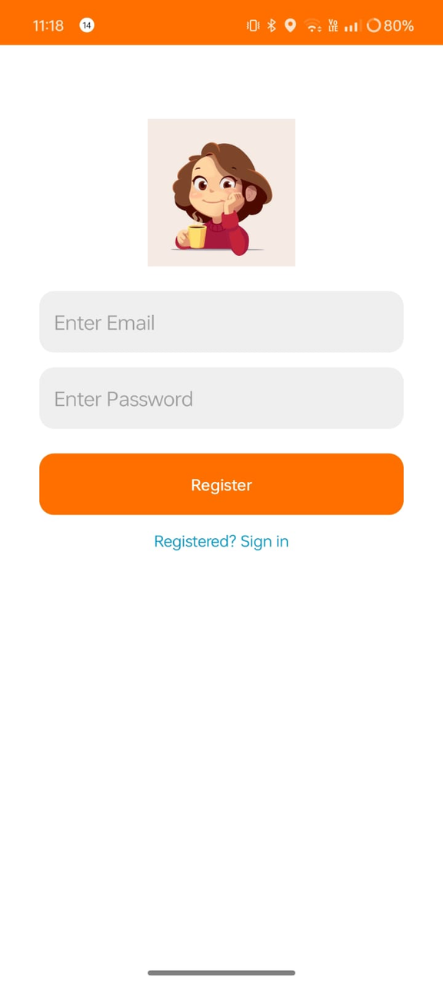
SHOP SMART
Home
Introduction
Similar Apps
Features
Results
eXPIRY tRACKER
Introduction
Shop Smart is a grocery expiry date tracker app that helps users manage grocery items, reduce waste, and stay notified before items expire.
It features an intuitive UI and essential utilities like:
Location tagging
Camera integration
Smart notifications

Slide 3
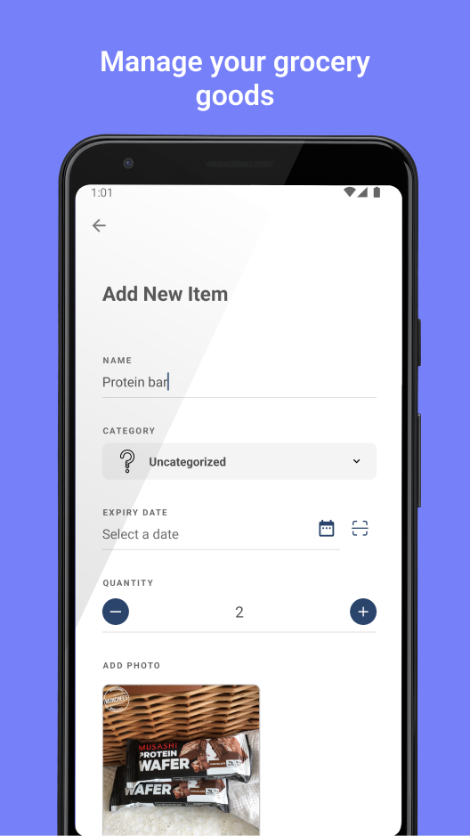
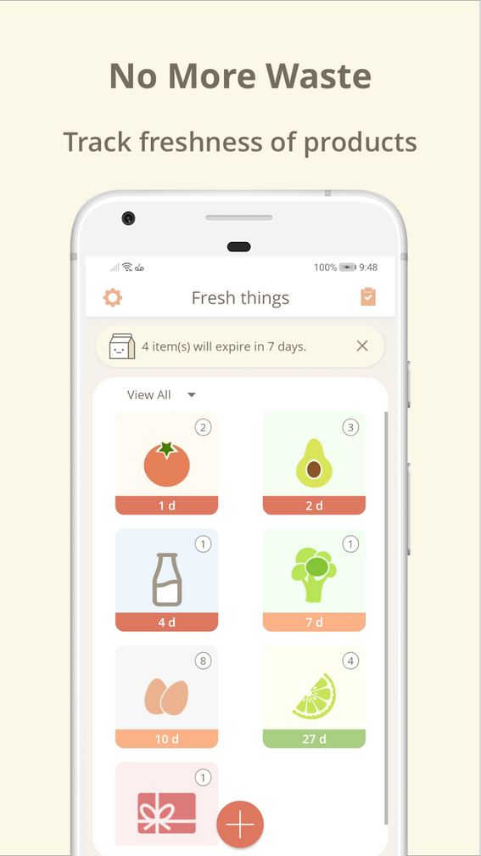
SHOP SMART
Home
Introduction
Similar Apps
Features
Results
EXPIRY TRACKER
SIMILAR
Apps
Compared to other apps:
Most offer only basic grocery lists
Lack features like:
Expiry tracking
Notification scheduling
WhatsApp messaging
Integration with local device features (camera, location)
Shop Smart solves all these gaps.

Slide 4

SHOP SMART
Home
Introduction
Similar Apps
Features
Results
Expiry Tracker
Apps Main
Features
1
2
Add & View ITEM
Map Integration
Users can easily add grocery items along with their expiry dates, quantity, and location, and later view the complete list with intuitive card layouts, pictures, and menu options for editing or deleting.
The app uses GPS-based location services to tag where items were added and provides a map view to locate nearby grocery stores, enhancing user convenience and planning.
3
4
Whatsapp & Message Remainder
Camera Function
Users can capture images of grocery items directly within the app using the built-in camera feature, helping with visual identification and inventory tracking.
Users can instantly send grocery expiry reminders to themselves or others via WhatsApp or SMS, ensuring that important items are not forgotten or wasted.

Slide 5
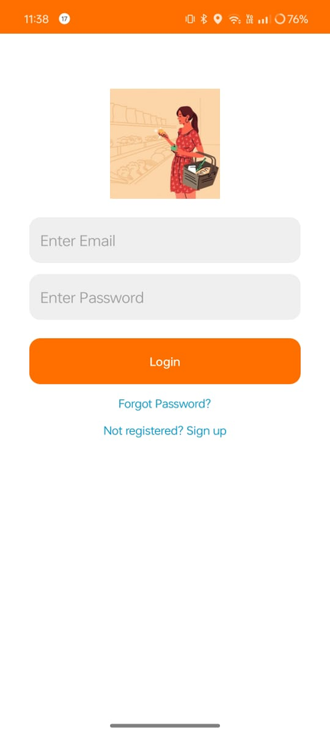

SHOP SMART
Home
Introduction
Similar Apps
Features
Results
EXPIRY TRACKER
RESULTS
Overview
Grocery items are successfully saved with expiry dates and location tags
Notifications are triggered one day before item expiry as intended
WhatsApp and SMS reminders are functioning correctly
Camera integration captures and stores item images accurately
Map integration displays user location and nearby grocery stores
Application tested across multiple devices with smooth performance and responsive UI

Slide 6
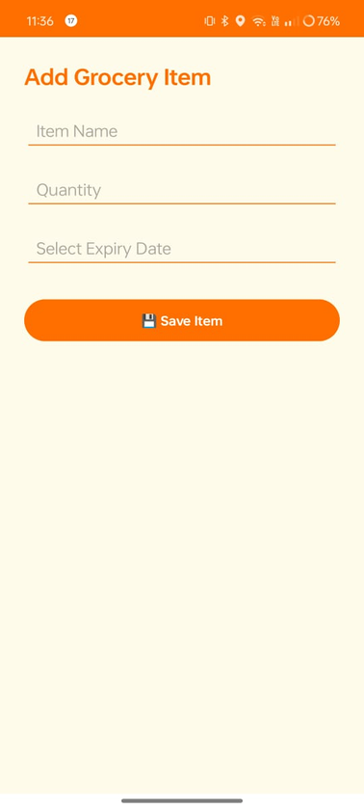
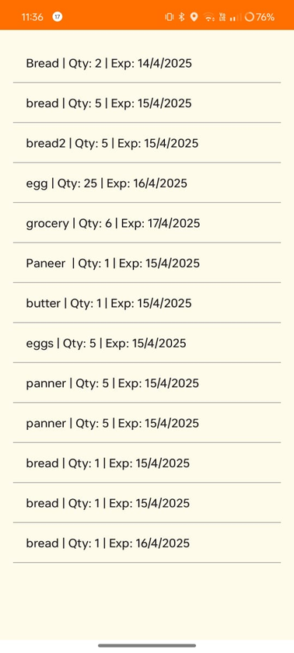
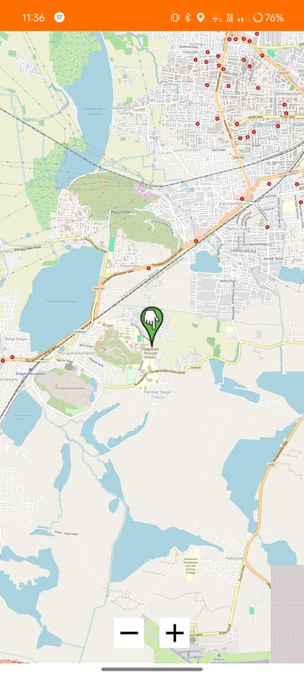
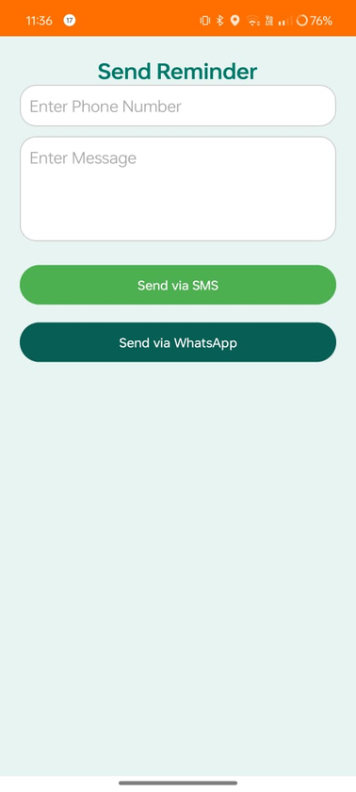
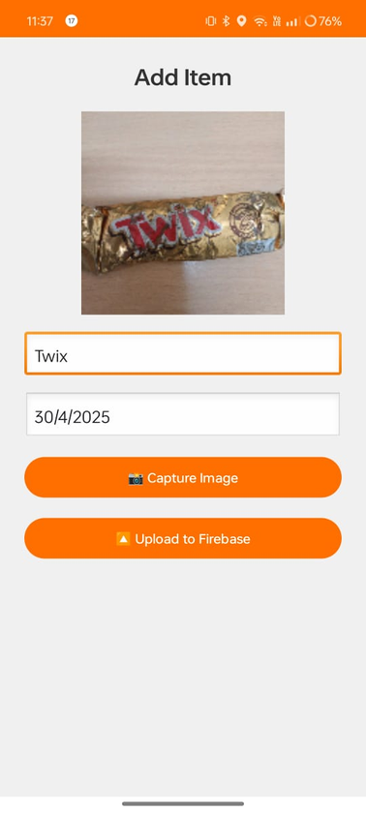
SHOP SMART
Home
Introduction
Similar Apps
Features
Results
EXPENCE TRACKER

Slide 7
SHOP SMART
Home
Introduction
Similar Apps
Features
Results
EXPIRY TRACKER
THANK
you!
SHOP SMART

